Slide 1
Exercise Data Analytics with R: Introduction to R
Exercise
Big Data in Medical Informatics
Dr. Oya Deniz Beyan
beyan@dbis.rwth-aachen.de
Kefang Ding
kefang.ding@rwth-aachen.de

Slide 2
Questions
Have you heard of Big Data?
Data sets that are so large or complex that traditional data processing applications are inadequate to deal with them.
Do you know data mining in Big Data?
Extraction of interesting information or pattern from data in big databases.
Have you heard of R?
Have you used R on data mining?
Have you used R on data mining in the medical field?
Notes:
Big data is a term for data sets that are so large or complex that traditional data processing applications are inadequate to deal with them.
Data Mining: Extraction of interesting (non-trivial, implicit, previously unknown and potentially useful) information or patterns from data in large databases

Slide 3
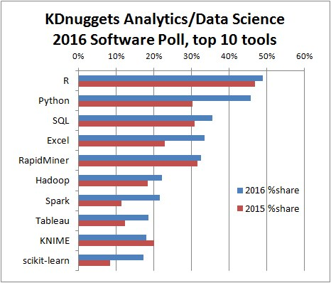
Top languages for data mining
http://www.kdnuggets.com/2016/06/r-python-top-analytics-data-mining-data-science-software.html

Slide 4
What is R?
R is an open source software package to perform statistical analysis on data.
R is an interpreted language; users typically access it through a command-line interpreter.
R is similar to the S language. R was developed by Ross Ihaka and Robert Gentleman at the University of Auckland, New Zealand, which is currently handled by the R Development Core Team.

Slide 5
R and Data Mining
R allows performing Data analytics by various statistical and data mining operations.
Regression
Classification
Clustering
Recommendation
Text mining
Visualization

Slide 6
Install R
Windows: Binary distribution
Download from the website https://cran.r-project.org/bin/windows/base/
Install via R-3.x.x-win.exe
** Building from source
Unix-alikes: https://cran.r-project.org/
download .tar files
exact the file
./configure
make
make check
Mac OS X: https://cran.r-project.org/
https://cran.r-project.org/doc/manuals/r-release/R-admin.html#Installing-R-under-OS-X
Notes:
When installing on a 64-bit version, the options will include 32 or 63-bit version of R(default is to install both)

Slide 7
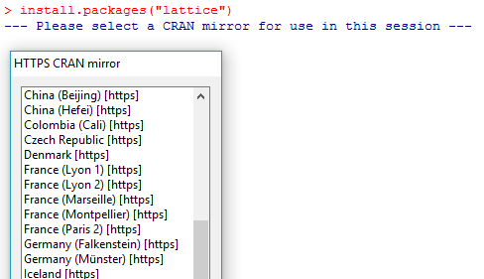

Basic Instructions
Install packages
install.packages(“package_name”)
install.packages(pkgs,lib,repos=getOption(“”),...
library() # load package
remove.packages(package_name) # remove installed package

Slide 8
Basic Instructions
Important Commands
get and set current directory: getwd() / setwd()
help: help(max) / ?max / help(“ if ”) / help.search() = ??max
remove objects: rm()
list objects: ls()
clear screen: ctrl + L
q() : quit from R
Comments starts with #
Semicolon: ; suppress the output

Slide 9
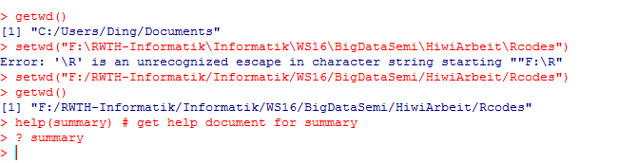
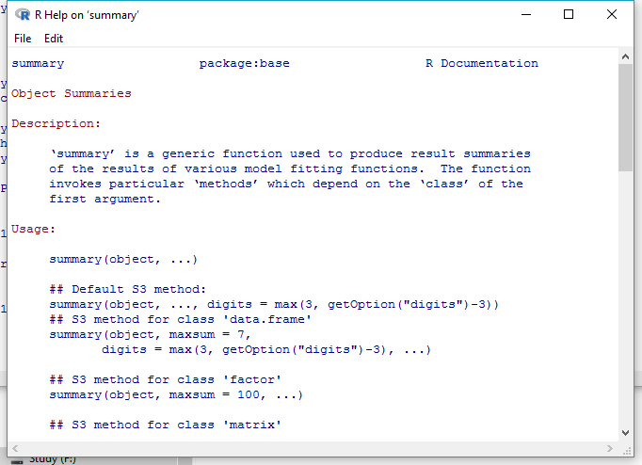
Basic Operations
get and set current directory: getwd() / setwd()
help()

Slide 10
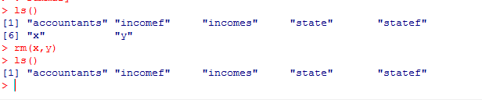
Basic Operations
remove objects: rm()
list objects: ls()

Slide 11
Outlines
data structure
control flow
function
data import/export

Slide 12
Data Structure
objects All entities in R are objects but with different modes!!
data types/mode
logical, integer,numeric,character,complex,...
NA(Not Available),NaN(Not a Number)
vector , array and matrices
list
factor
data frame
Notes:
Objects Examples are vectors of numeric (real) or complex values, lists, data.frame, function...
mode: understood as “atomic”data type, namely numeric, complex, logical, character and raw.

Slide 13
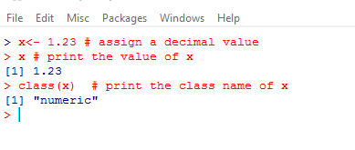
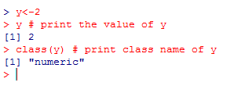
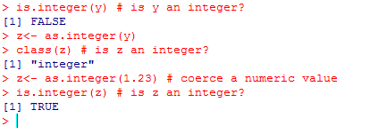
Data Types
Numeric
Integer
http://adv-r.had.co.nz/memory.html
Notes:
numeric is like double under C and other languages.
integer is integer but there are some differences.
like 2,4 integer inputs under R will be taken as numeric (like double), To be integer it needs using function as.integer() to transform it.
For the storage mechanism we could look for the article onliine http://adv-r.had.co.nz/memory.html .

Slide 14
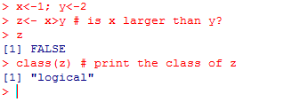
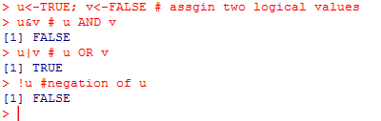
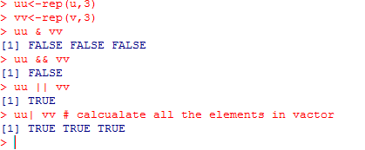
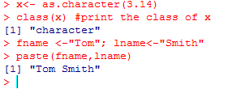
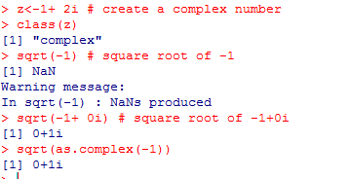
Data Types
Logical
A logical value is often created via comparision and used for relation operations.
Character
A character object is used to represent string values in R.
Complex
A complex value in R is defined via the pure imaginary value i.
Notes:
The “short-circuit” operators && and || are often used as part of the condition in an if statement. Whereas & and | apply element-wise to vectors, && and || apply to vectors of length one, and only evaluate their second argument if necessary.
If we want to manipulate Complex , we need to specify the image part by adding i,or j.

Slide 15
vector , array and matrices
All data of the same mode;
A vector is a single entity consisting of an ordered collection of data.
An array has a dimension vector as its dim attribute. A vector can be used as array, only if set attributes dim(z)
A matrix is just an array with two subscripts.
Default arithmetic operation is element-by-element. Matrix operation is %operator%

Slide 16
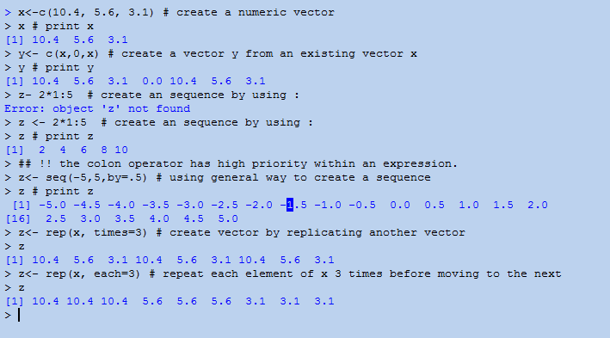
Basic Operations
create vectors
Notes:
There are some comments on the programs running..
rep(x, times=3) it means it copy x 3 times.
rep(x, each =3) means it repeats each element of x 3 times before moving on to the next.

Slide 17
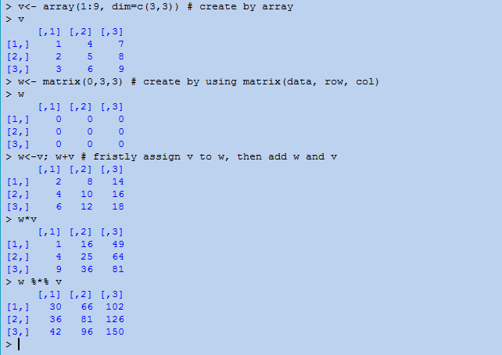
Basic Operations
arithmetic operation: elemnt by elemnt
matrix operation with %*%

Slide 18
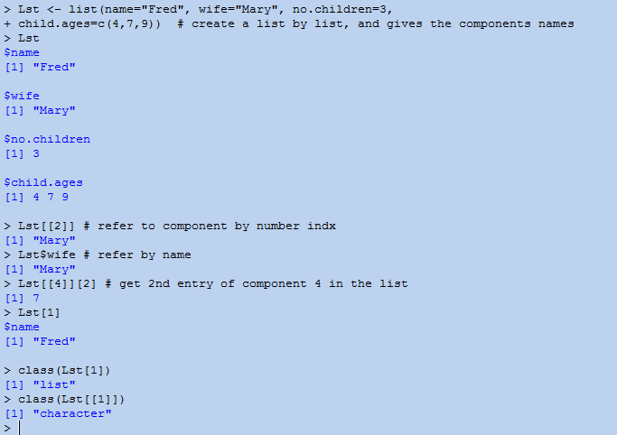
List
Ordered sequences of objects which individually can be of any mode

Slide 19
Factor and Dataframe
A Factor like a label is a vector object used to specify a discrete classification of the components of other vectors of the same length.
A data frame is a list with class “data.frame” and restrictions on list. Vector structures appearing as variables of the data frame must all have the same length,and matrix structures must all have the same row size.
A data frame may for many purposes be regarded as a matrix with columns possibly of differing modes and attributes. It may be displayed in matrix form, and its rows and columns extracted using matrix indexing conventions.
character vectors by default are coerced to be factors, whose levels are the unique values appearing in the vector.

Slide 20
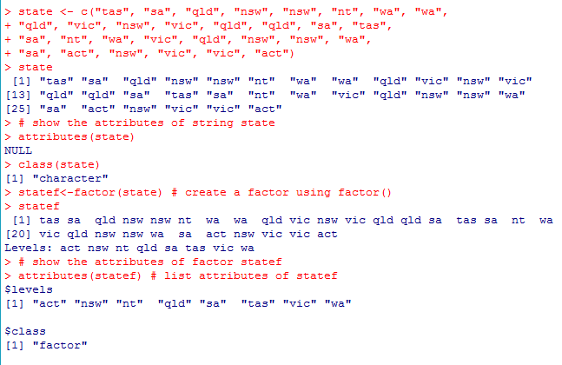
Factor
Notes:
Suppose, for example, we have a sample of 30 tax accountants from all the states and territories
of Australia1 and their individual state of origin is specified by a character vector of state
mnemonics as state..
A factor is like a label vector and similarly created using the factor() function.
levels: like an collection of labels. It is an optional vector of the values (as character strings) that 'x' might have taken.
To find out the levels of a factor the function levels() can be used.
> levels(statef)
[1] "act" "nsw" "nt" "qld" "sa" "tas" "vic" "wa"

Slide 21
Data Frame
working with data frame:
1. gather together all variables for any well defined and separate problem in a data frame under a suitably informative name;
2. when working with a problem attach the appropriate data frame
3. before leaving a problem, add any variables you wish to keep for future reference to the data frame using the $ form of assignment, and then detach();
4. finally remove all unwanted variables from the working directory and keep it as clean of left-over temporary variables as possible.
Notes:
comments.. notes.

Slide 22
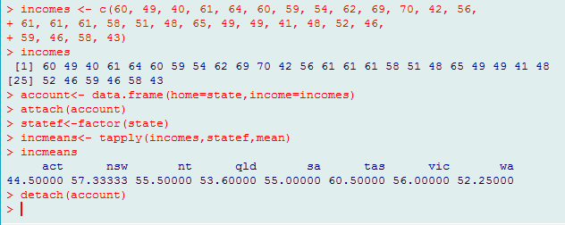
Data Frame
collect data state and incomes and use data.frame to bind them
account<- data.frame(home=state,income=incomes)
use attach to access data.frame
attach(account)
Do manipulation on data: get the mean of incomes of each states
incmeans<- tapply(incomes,statef,mean)
Detach data
detach(account)
Notes:
Suppose, for example, we have a sample of 30 tax accountants from all the states and territories
of Australia1 and their individual state of origin is specified by a character vector of state
mnemonics as state
To continue the previous example, suppose we have the incomes of the same tax accountants in
another vector (in suitably large units of money) in incomes:
To calculate the sample mean income for each state we can now use the special function
tapply():
> incmeans <- tapply(incomes, statef, mean)

Slide 23
Control Statements
if( condition) expr_2 else expr_3
for(var in seq) expr
while(condition) expr
repeat expr
next/ break
‘break’ breaks out of a ‘for’, ‘while’ or ‘repeat’ loop; control is transferred to the first statement outside the inner-most loop.
‘next’ halts the processing of the current iteration and advances the looping index.
Both ‘break’ and ‘next’ apply only to the innermost of nested loops.

Slide 24
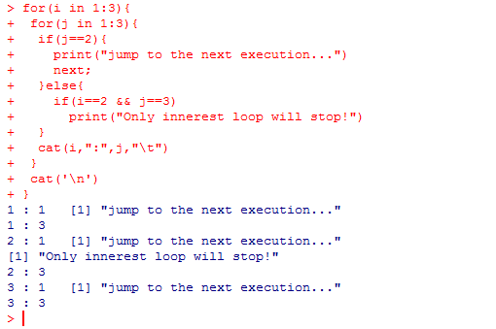
Function

Slide 25
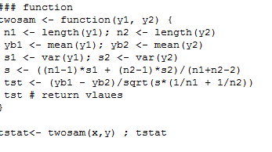
Function
A function is defined by an assignment of the form
name <- function(arg_1, arg_2, ...) expression
A call to the function then usually takes the form name(expr_1, expr_2, ...)

Slide 26
Data Import/Export
Read data from and write data to
R native formats
Access builtin datasets
Text files
CSV files
Excel files
ODBS databases
http://cran.r-project.org/doc/manuals/R-data.pdf

Slide 27
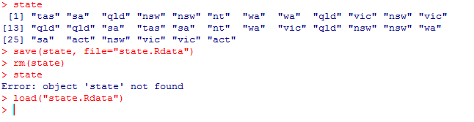
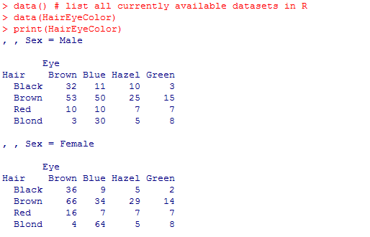
Data Import/Export
R Native format
Access R Builtin Datasets

Slide 28
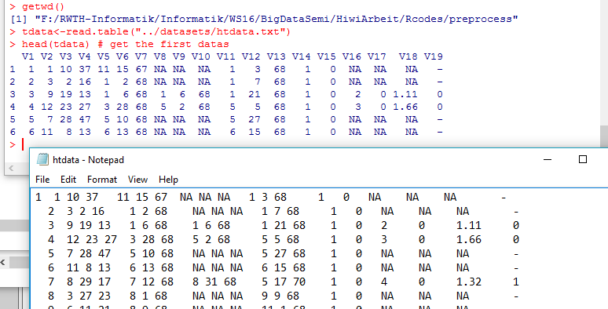
Data Import/Export -- From files
reading tabular data into R
read.table(file,header=FALSE,sep=””,as.is=!stringsAsFactor) / read.csv()

Slide 29
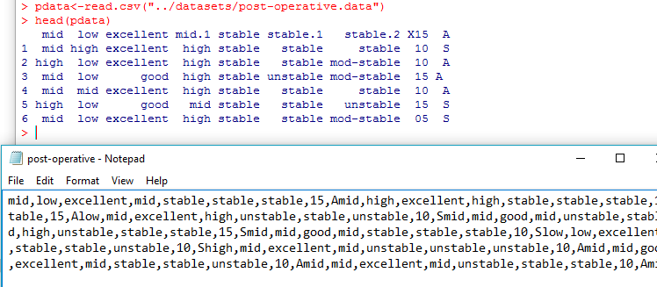
Data Import/Export
reading tabular data into R
‘read.csv’ is identical to ‘read.table’ except for the defaults. They are intended for reading ‘comma separated value’ files

Slide 30
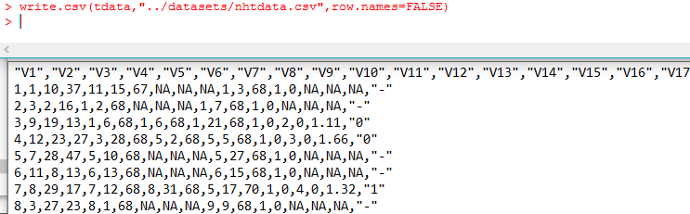
Data Import/Export
Reading arbitrary data from the console or file
scan(file=””,what=double(),nmax=-1,n=-1,sep=””)
Write data to file
write.table(x,file=””,append=FALSE,quote=TRUE,seq=””,...)
write.csv(...)

Slide 31
Data Import/Export
Excel files
Package: xlsx read.xlsx(), write.xlsx()
Datasets
Package RODBC: provide connection to ODBC
Function odbcConnect(): sets up a connection to database
I sqlQuery(): sends an SQL query to the database
I odbcClose() closes the connection.

Slide 32
References
[1] Jiawei Han, Micheline Kamber, Jian Pei: Data Mining – Concepts and Techniques, 3rd ed., Morgan Kaufmann Publishers, 2011.
http://www.cs.uiuc.edu/~hanj/bk3
[2] https://en.wikipedia.org/wiki/Big_data
[3 ] https://cran.r-project.org/
[4] http://www.rdatamining.com/
[5] An Introduction to R

